Slide 1
Introduction to R ggplot2
Shyh-Weir Tzang
Asia University
2017/8/30

Slide 2
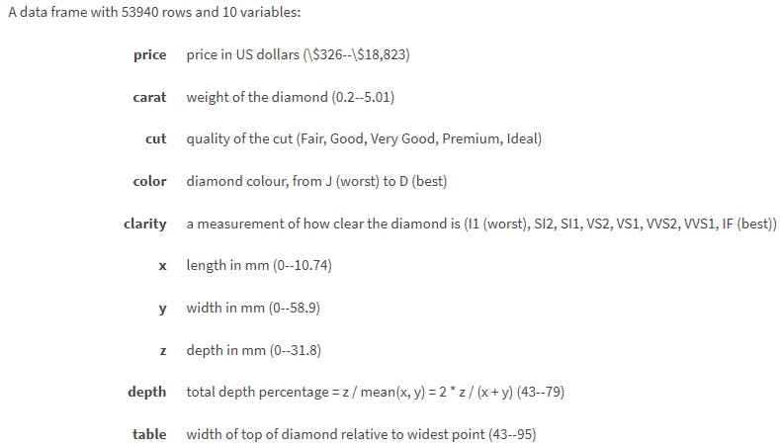
Datasets: diamonds

Slide 3
Datasets: iris
This famous (Fisher's or Anderson's) iris data set gives the measurements in centimeters of the variables sepal length and width and petal length and width, respectively, for 50 flowers from each of 3 species of iris. The species are Iris setosa, versicolor, and virginica.
iris is a data frame with 150 cases (rows) and 5 variables (columns) named Sepal.Length, Sepal.Width, Petal.Length, Petal.Width, and Species.

Slide 4
Dataset: mtcars
The data was extracted from the 1974 Motor Trend US magazine, and comprises fuel consumption and 10 aspects of automobile design and performance for 32 automobiles (1973–74 models).
A data frame with 32 observations on 11 variables.
[, 1] mpg Miles/(US) gallon
[, 2] cyl Number of cylinders
[, 3] disp Displacement (cu.in.)
[, 4] hp Gross horsepower
[, 5] drat Rear axle ratio
[, 6] wt Weight (1000 lbs)
[, 7] qsec 1/4 mile time
[, 8] vs V/S (V engine or straight engine)
[, 9] am Transmission (0 = automatic, 1 = manual)
[,10] gear Number of forward gears
[,11] carb Number of carburetors
Reference:
https://rstudio-pubs-static.s3.amazonaws.com/45786_b5e54c2d3c824f51abd2d559506cf81f.html

Slide 5
Dataset: movies (library ggplot2movies)
A dataset about movies. This was previously contained in ggplot2, but has been moved its own package to reduce the download size of ggplot2.
A data frame with 28819 rows and 24 variables
• title. Title of the movie.
• year. Year of release.
• budget. Total budget (if known) in US dollars
• length. Length in minutes.
• rating. Average IMDB user rating.
• votes. Number of IMDB users who rated this movie.
• r1-10. Multiplying by ten gives percentile (to nearest 10%) of users who rated this movie a 1.
• mpaa. MPAA rating.
• action, animation, comedy, drama, documentary, romance, short. Binary variables represent-
ing if movie was classified as belonging to that genre.
Reference:
http://www.arietwigt.com/articles/R_IMDB.html
http://www.reed.edu/data-at-reed/software/R/workshops/2015/vis_homework_solutions.html
http://tutorials.iq.harvard.edu/R/Rgraphics/Rgraphics.html

Slide 6
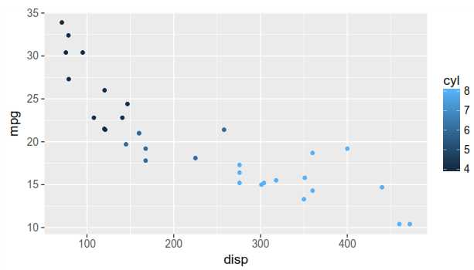
data(mtcars)
ggplot(data=mtcars,aes(x= disp,y = mpg,color= cyl))
Try a different mapping: mpg→color, cyl→y.

Slide 7
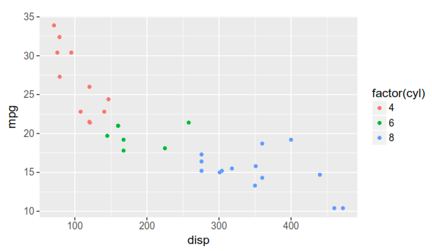
ggplot(data = mtcars, aes(x = disp, y = mpg, color = factor(cyl))) + geom_point()

Slide 8
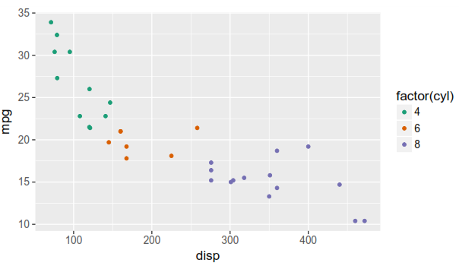
Using different palette
ggplot(data =mtcars, aes(x = disp, y = mpg, color = factor(cyl))) +
geom_point() +
scale_color_brewer(type = "qual", palette = 2)

Slide 9
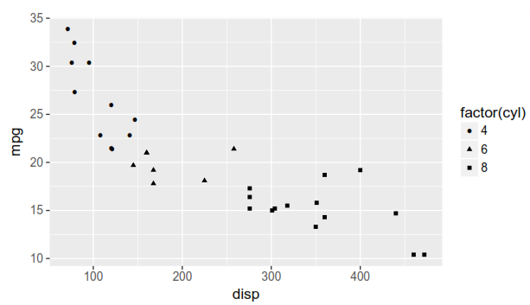
Using different shapes
ggplot(data = mtcars, aes(x = disp, y = mpg, shape = factor(cyl))) + geom_point()

Slide 10
